Slide 1
Healthcare Expense Predictions
Daniel Flores

Slide 2
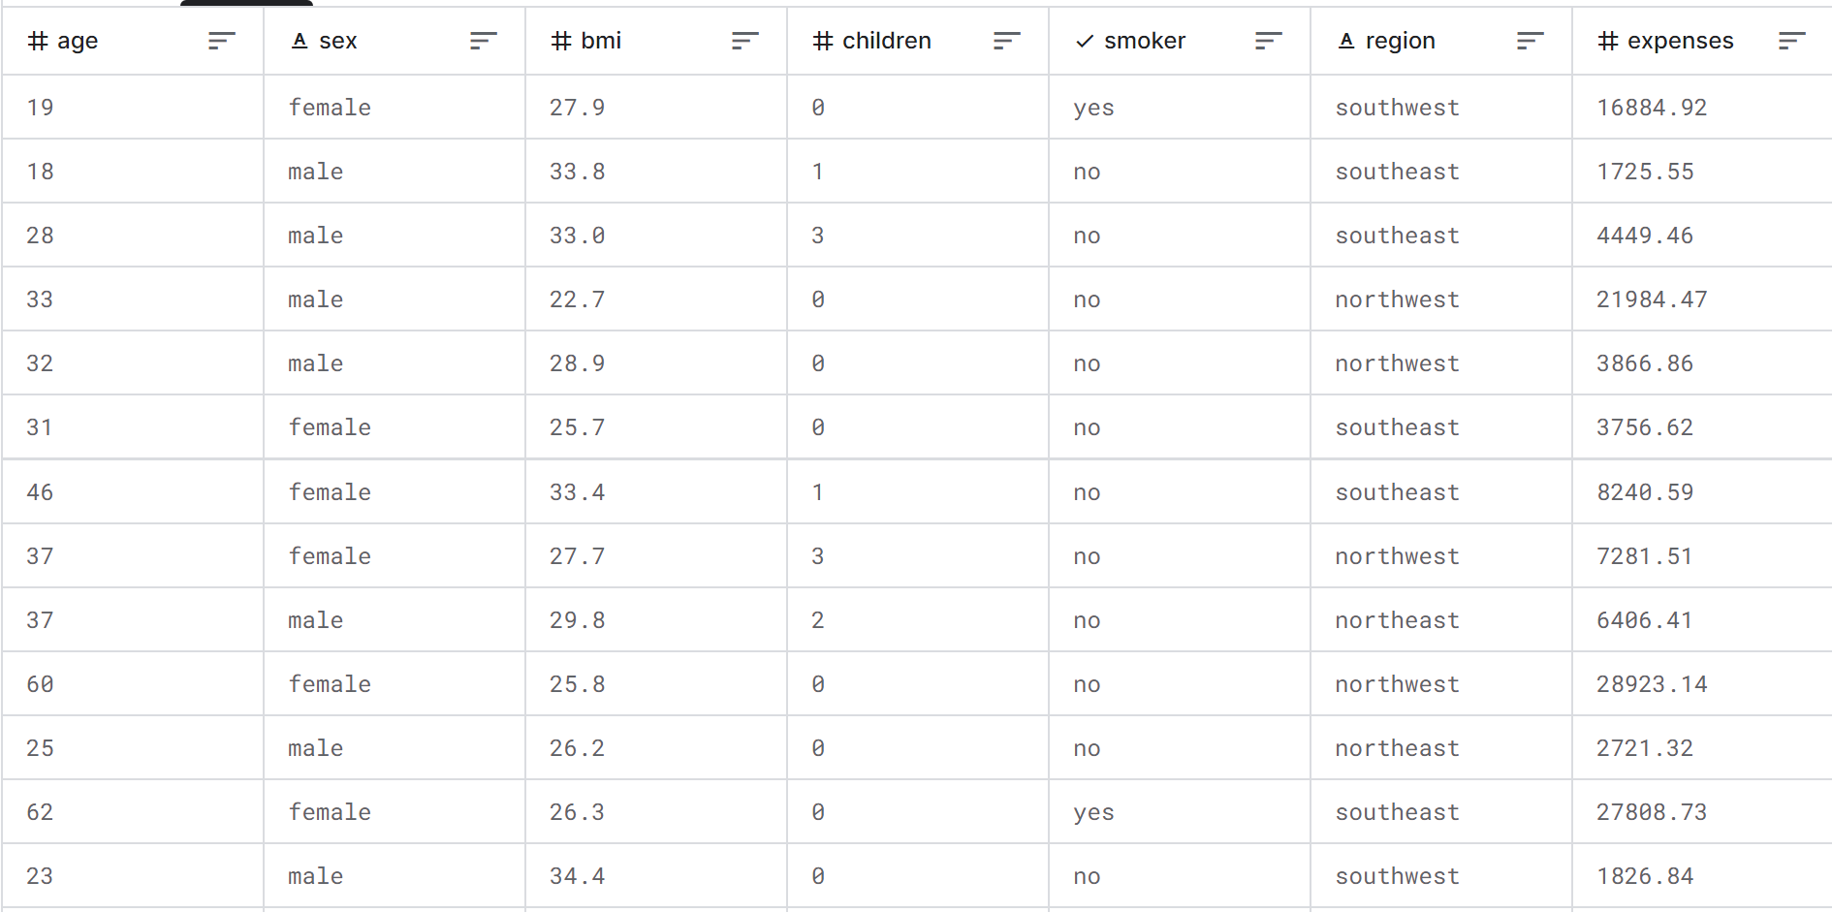
Introduction
- My goal is to create a multiple linear regression model that predicts medical expenses using this dataset from Kaggle.(1,338 rows, 7 columns)
-Can we create an accurate model?
-Which features are the most statistically significant.
>Data
>Methods
>Analysis
>Conclusion
>Appendix

Slide 3
Data
Dataset consists of 1,338 rows and 7 columns
Region feature dropped
Categorical Transformation
-4 numeric data (age, bmi, children, expenses)
-3 categorical data (sex, smoker, region)
-Expenses is our target variable, the rest are independent variables
-I decided to drop this feature, as I don’t want vague categorical data in the model
- Transformed sex and smoker features from strings to numeric quantitative values
- For sex, 0 = female, 1 = male
-For smoker, 0 = non-smoker, 1 = smoker

Slide 4
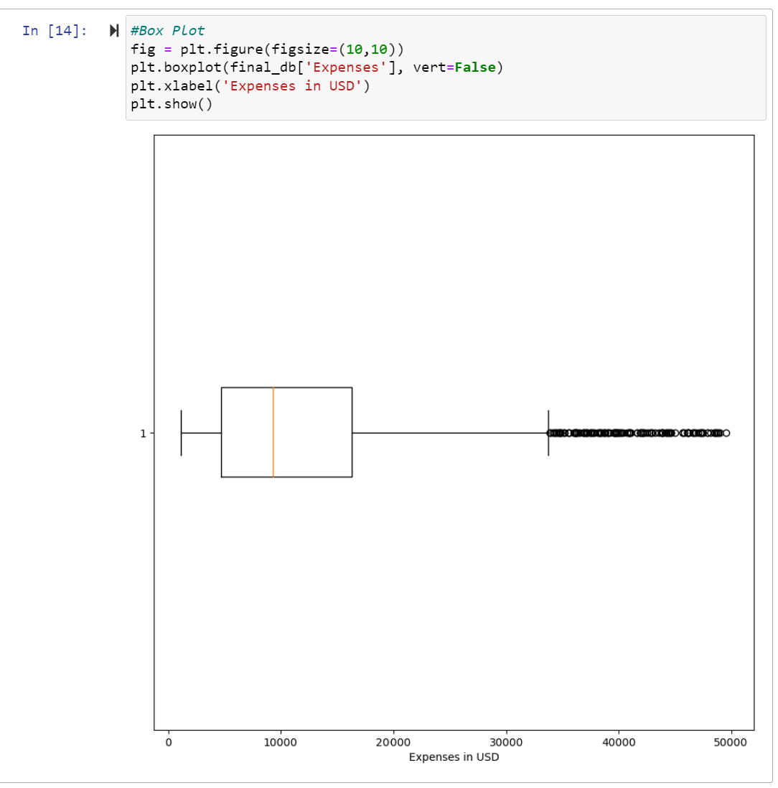
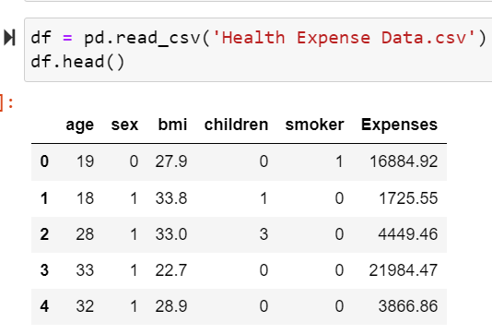
Data
.head() of our data to be used in our model
Distribution of medical expenses in our sample dataset

Slide 5
Methods
Multiple Regression
Jupyter Notebook, Python, imports below
Data split into test and train groups,
Since we are using multiple numeric features, we multiple regression is the appropriate model to use.
import pandas as pd
import seaborn as sns
import numpy as np
import matplotlib.pyplot as plt
from sklearn.linear_model import LinearRegression
from sklearn.model_selection import train_test_split
from sklearn.metrics import mean_squared_error
from scipy import stats
import statsmodels.api as sm
import statsmodels.formula.api as smf
from sklearn.preprocessing import LabelEncoder
>Testing group size of .2
>Allows us to train the model with 80% of our data, then test using the remaining 20%

Slide 6
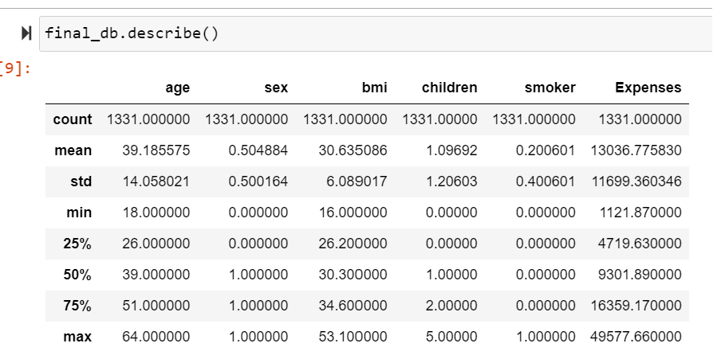
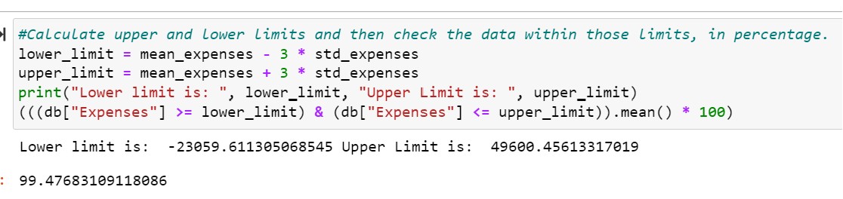
Analysis
Removing Outliers using the mean and standard deviation of expenses
Descriptive statistics of each feature

Slide 7
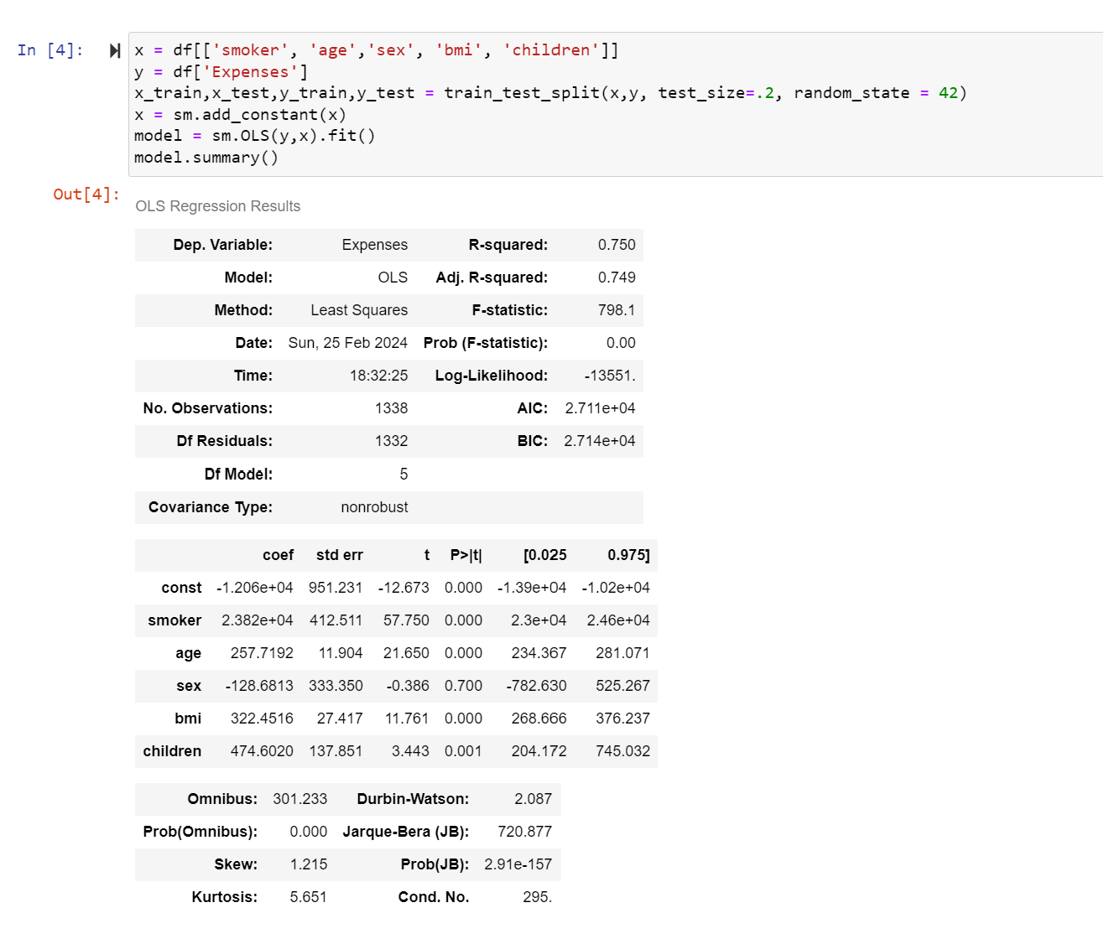
Analysis (model training and summary)
Model Summary
R-squared value of .75 represents a model whose independent variables is responsible for 75% of the target variables variance. F statistic shows a high number of 798, also showing a strong correlation with the model.

Slide 8
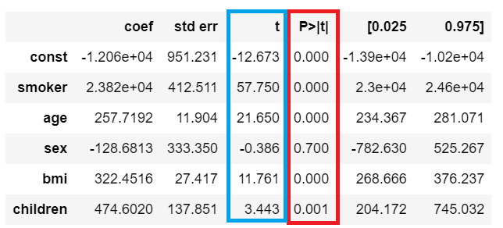
Analysis (feature Significance)
- T-score in blue, P-value in red
- The further from 0 the t-score is, the more statistically significant
-The closer to 0 the p-value, the more statistically significant

Slide 9
Conclusion
>Multiple regression model created using dataset of independent variables, and the target variable, the medical expenses
>R-squared value of .75 shows a strong model was constructed
>Smoking and age were the most statistically significant features, number of children and gender was the least

